Slide 1
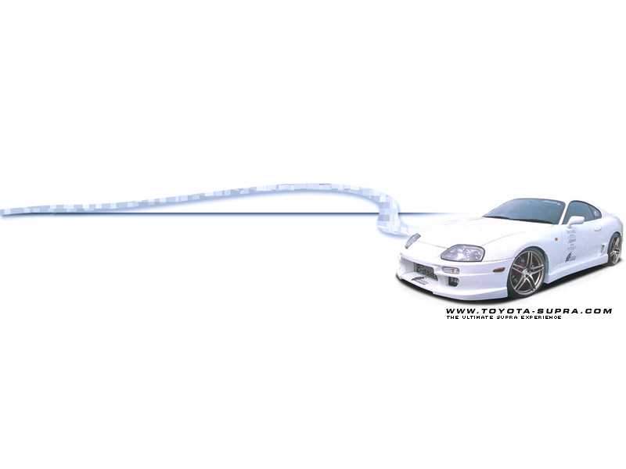
Purchase of
New Car Model

Slide 2
































Slide 3
Overview
Problem Definition
Objective
Assumptions
Decision Variables
Model Evaluation
Showcase of Model
Rationale & User Guide
Formulation of Model
Questions & Answers

Slide 4
Problem Definition
Wide Variety of Cars Available
Lack of information
Difficult process to decide on desired car
Car is an important Asset and Careful decision must be made
Diverse tastes and preferences
Difficulties in calculating trade-in values / car loans

Slide 5
Objective
Help car buyers streamline the wide array of car models available
Create convenience and information for the user, assisting in decision making for purchasing a vehicle of choice
Providing loan management guidelines for the end user

Slide 6
Assumptions
No Price Differentiation
Trade in vehicle value calculated based on “scrap” value
Vehicle and financial data obtained are reliable & accurate
COE prices have low variations and standard deviations

Slide 7
Decision Variables
Current COE prices
Vehicle requirements:
  Model of vehicle
  expected budget
  engine capacity
  top speed
Trade in value of old car (if any)
Loan requirements: Current interest rates,
expected years of loan, initial down payment

Slide 8
Model Evaluation
Criterions are:
  Model is user- friendly
  Effective in providing end user with feasible solution
  (given constraints)
  Useful in end user’s decision making.
Users polled to test the model
Responses - easy to use
- understand the model
- would use it again in future

Slide 9
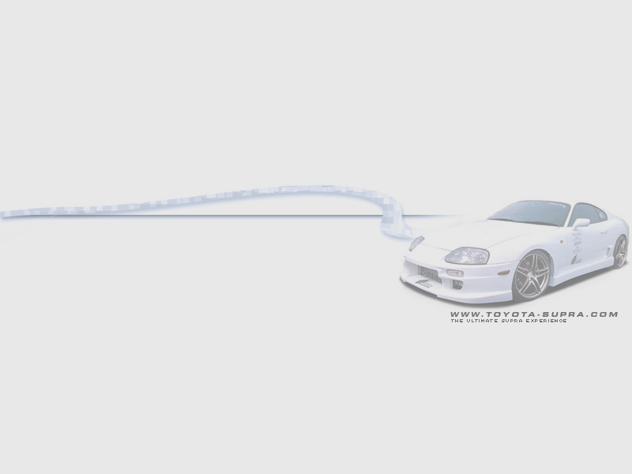
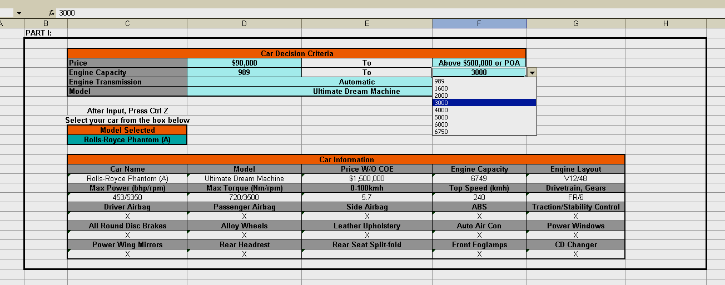
Rationale & User Guide
Part I
Car Price
Engine Capacity
Engine Transmission
Car Model

Slide 10
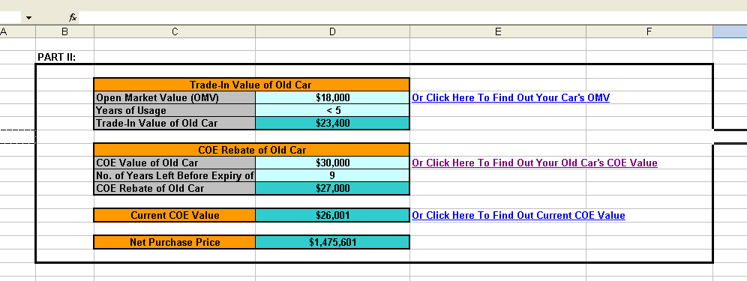
Rationale & User Guide
Part II
Trade In Value
COE Rebate Of Old Car
Net Purchase Price (NPP)

Slide 11
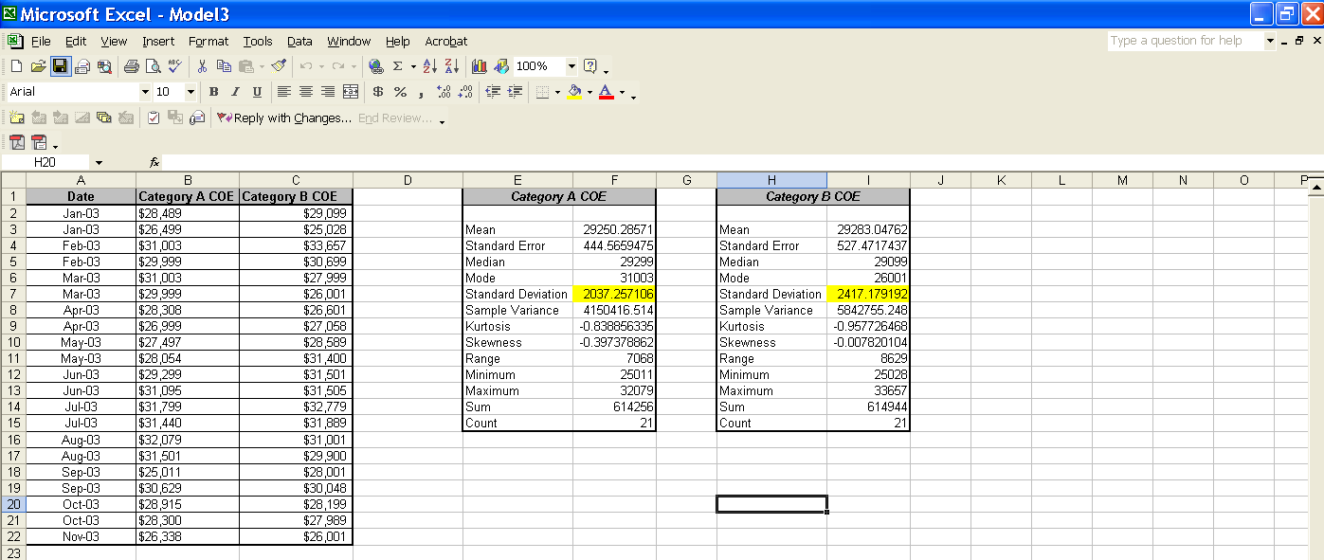
Rationale & User Guide
Part II con’t

Slide 12
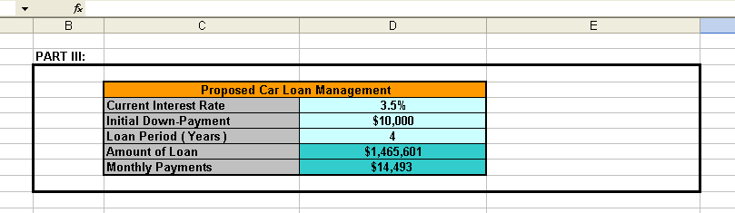
Rationale & User Guide
Part III
Car Loans

Slide 13
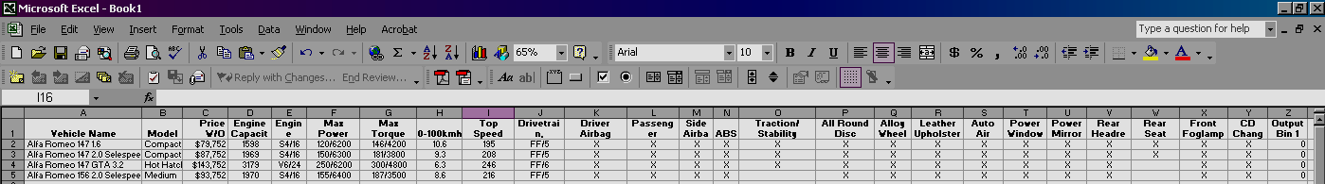
Formulation of Model
Common Car Accessories and Luxury Items
Alloy Wheels
Leather Upholstery
Auto Air Con
Power Windows
Power Wing Mirrors
Rear Headrest
Rear Seat Split-Folds
Front Fog Lamps
CD Changer
Car Name
Model
Price (W/O Coe)
Engine Capacity
Engine Layout
Max Power (Bhp/Rpm)
Max Torque (Nm/Rpm)
0-100 Km
Top Speed (Kmh)
Drive-Train
Gears
Safety accessories
Driver Airbag
Side Airbag
Anti-Brake System (ABS)
Traction/ Stability Control
All-Round Disc Brakes

Slide 14
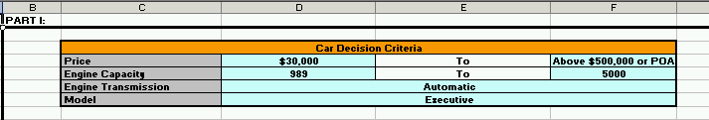
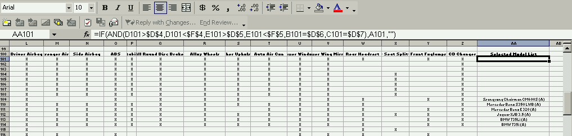
Formulation of Model

Slide 15
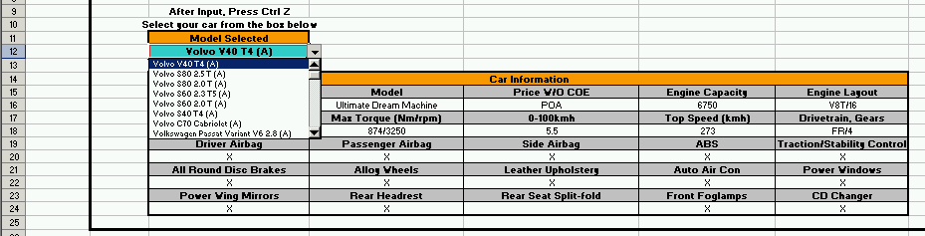
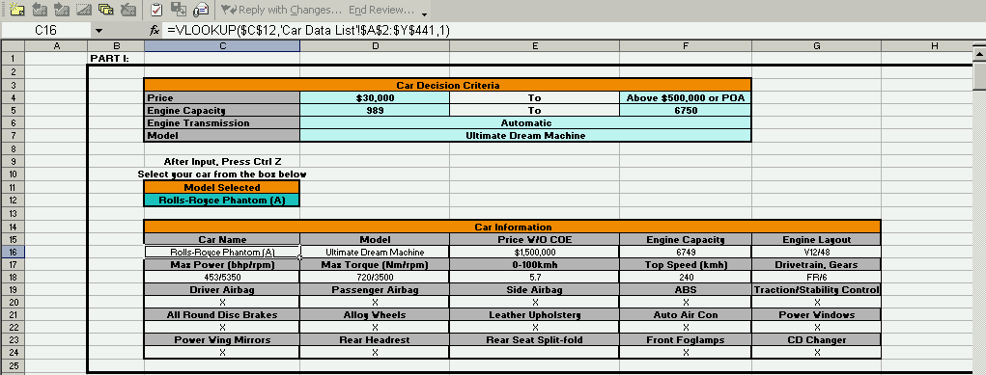
Formulation of Model

Slide 16
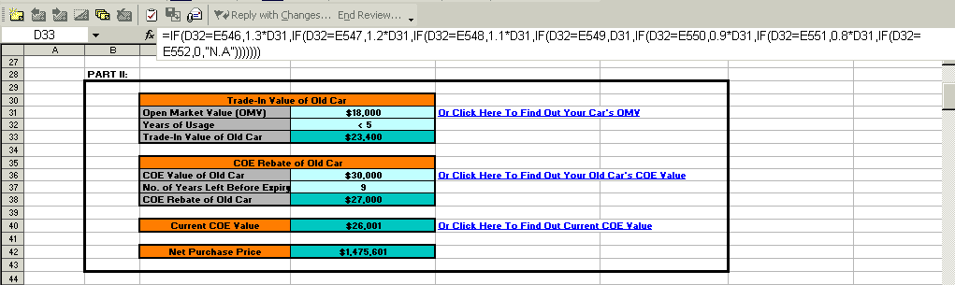
Formulation of Model

Slide 17
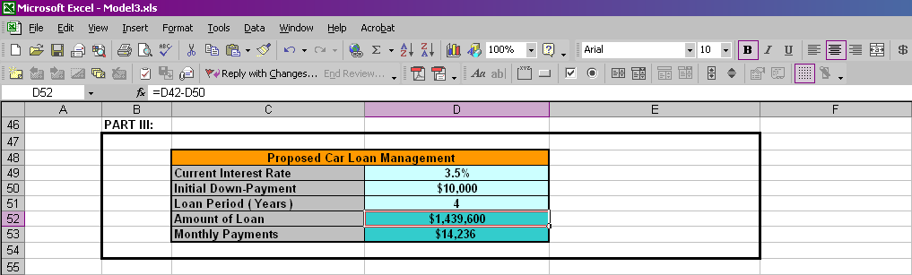
Formulation of Model

Slide 18
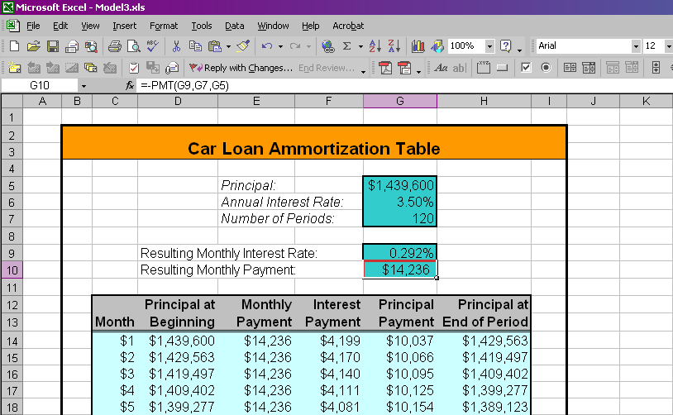
Formulation of Model

Slide 19
Now Presenting
Purchase of
New Car Model

Slide 20

A CAT PROJECT BROUGHT TO YOU BY
Eng Song Hao, Kevyn
Hwang E-wan
Loh Sen Loong, Joey
Yang Haoyi, Rason
Advisor & Lecturer : Prof Leong TY
OPIM201 Computer as an Analysis Tool G7

Slide 21

Questions?

Slide 22
ThE EnD
Purchase of
New Car Model

